Slide 1

DIRECTORATE OF ONLINE EDUCATION
SRM INSTITUTE OF SCIENCE AND TECHNOLOGY
KATTANKULATHUR- 603 203
MCA IV SEM
PROJECT VIVA VOCE
December 2024
ENROLMENT NUMBER : EC2332251010130
NAME OF STUDENT: MONALIKA GHOSH

Slide 2
CRICKET DATA ANALYSIS PROJECT USING WEB SCRAPING, PYTHON, PANDAS & POWER-BI
PROJECT GUIDE : Dr. Umamaheswari. Km

Slide 3
CONTENTS
Abstract
Introduction
Project Scope
UML Diagram
Features
Module Description
System Requirements
Existing System vs Proposed System
9. Proposed System
10. Data Flow Diagram- Power BI
Output Screenshots
Source Code
Conclusion
Feature Enhancements
References

Slide 4
ABSTRACT
The "Cricket Data Analysis Project Using Web Scraping, Python, Pandas, and Power BI" explores the potential of data science and visualization tools to analyze cricket data, with a focus on the Indian Premier League (IPL). The project automates data collection from online sources using Python libraries like BeautifulSoup and Selenium, processes the data using Pandas, and conducts exploratory data analysis to uncover trends and insights. Finally, Power BI is employed to create interactive dashboards that visualize player performances, match outcomes, and other key metrics. This scalable framework demonstrates the application of modern tools in sports analytics, providing valuable insights for teams, analysts, and fans.
Keywords: Cricket data analysis, IPL, Exploratory Data Analysis, Data Visualization, Python, Pandas, Power BI.

Slide 5
INTRODUCTION
SignificanceProvides actionable insights for analysts, coaches, and fans.
Demonstrates the application of data science in sports analytics.
Offers a scalable framework adaptable to other domains.
Cricket generates vast amounts of data through leagues, tournaments, and individual performances.
This data provides insights into player performance, team strategies, and match outcomes.
The unstructured nature of this data across platforms makes collection and analysis challenging.
Project Overview
The "Cricket Data Analysis Project Using Web Scraping, Python, Pandas, and Power BI" addresses these challenges.
Web Scraping: Automates data extraction from sources like ESPN Cricinfo using Python libraries (BeautifulSoup, Selenium).
Data Processing: Uses Pandas for cleaning and transforming raw data into structured formats.
Visualization: Integrates Power BI to create interactive dashboards for key cricket statistics and trends.

Slide 6
INTRODUCTION
Data Analysis Overview
Data analysis involves systematically applying statistical and logical techniques to describe, summarize, and evaluate data.Purpose: Helps uncover patterns, trends, and relationships for informed decision-making.
Process Steps:
Data Collection: Gather data from sources like surveys, databases, or web scraping.
Data Cleaning: Correct inaccuracies or inconsistencies for quality and reliability.
Data Transformation: Prepare data for analysis by normalizing, aggregating, or creating new variables.
Data Analysis: Use statistical methods to explore and extract insights.Data Interpretation: Translate findings into actionable recommendations.
In this project we aim to automate the above manual process as follows :
To develop a modular system for efficient cricket data collection, processing, and analysis.
Automate data extraction using Python (BeautifulSoup, Selenium) from platforms like ESPN Cricinfo and Cricbuzz.
Clean and transform raw data into structured formats using Pandas for accurate analysis.
Conduct Exploratory Data Analysis (EDA) with Matplotlib and Seaborn to identify trends and patterns.
Create interactive dashboards in Power BI for visualizing player and team performance metrics.
Deliver a scalable framework for actionable insights to enhance decision-making in cricket analytics.

Slide 7
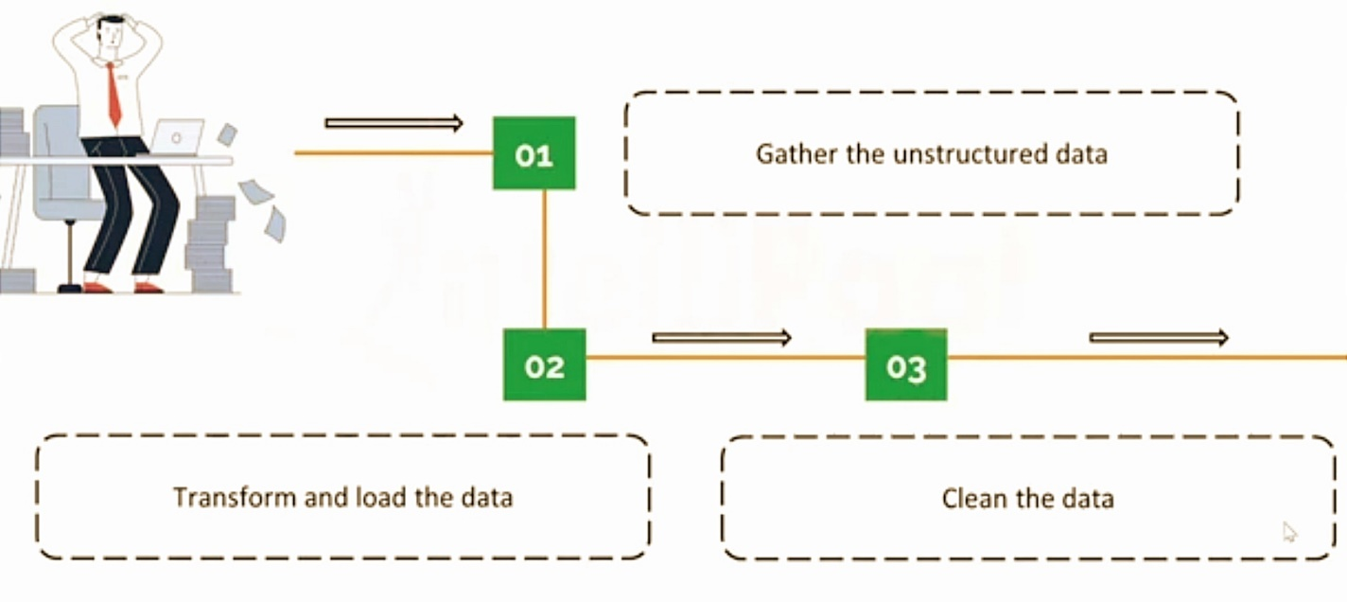
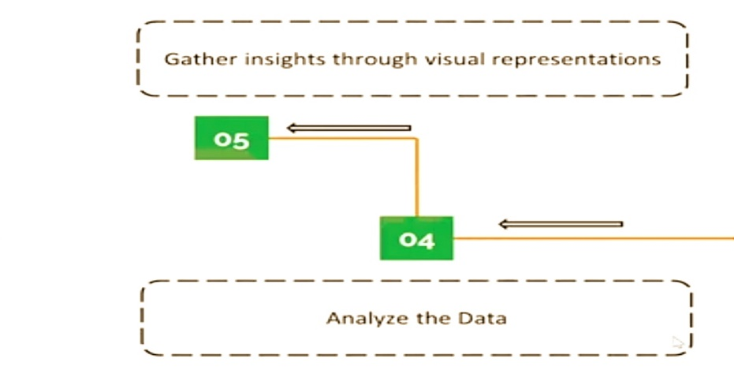
PROJECT SCOPE
Process flow of the automated system

Slide 8
PROJECT SCOPE
The project aims to create a data pipeline that automates cricket data collection, processes it for analysis, and visualizes insights. This will enable analysts, coaches, and fans to derive actionable insights through streamlined data extraction, transformation, and presentation.
Data Pipeline: Automates cricket data collection, processing, and visualization to generate actionable insights.
Data Collection (Web Scraping): Extracts match statistics and player performance from platforms like ESPN Cricinfo using Python libraries (BeautifulSoup, Selenium).
Data Processing (Python & Pandas): Cleans and structures raw data for analysis, ensuring accuracy and consistency.
Exploratory Data Analysis (EDA): Identifies performance trends and anomalies using visual tools like Matplotlib and Seaborn.
Data Visualization (Power BI): Creates interactive dashboards for stakeholders to explore insights on player performance, match outcomes, and team strategies.
Scalable and Adaptable: Framework supports other cricket formats and can integrate predictive analytics in the future.

Slide 9
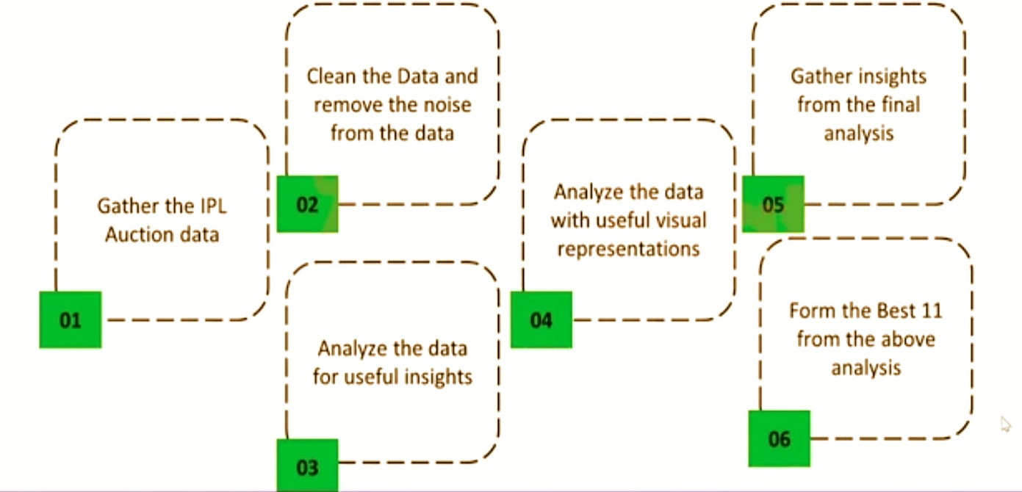
UML Diagram
Steps for IPL Data Analysis

Slide 10


FEATURES
Modularity and Scalability
Modularity: The project is divided into distinct modules (data collection, processing, analysis, and visualization).Each module performs a specific function, making the system easier to develop, debug, and maintain.
Scalability: The architecture can handle increasing volumes of data as cricket datasets grow with new matches and tournaments.
Automation to Ensure Timely and Updated Data
Website extraction Automated Data Collection : Web scraping scripts periodically or on-demand gather data from platforms like ESPN Cricinfo and Cricbuzz.This ensures the latest match statistics and player performance metrics are readily available. Automation reduces manual intervention, minimizing errors in data extraction and processing.
Easy and flexible scheduling
Interactive Dashboards: Power BI dashboards allow users to explore data based on specific interests like player performance, team comparisons, and match outcomes.Visualizations are designed for simplicity, enabling stakeholders to easily interpret complex insights.
Customizable Views: Users can personalize views to focus on key metrics such as batting averages, bowling economy, and win-loss ratios.j

Slide 11
FEATURES
Data Reliability and Accuracy:
Ensures accurate data collection and cleaning to maintain analysis integrity.
Adaptability Across Use Cases:
Can be adapted for different cricket formats or sports, supporting future machine learning integration.
Real-Time Insights Capability
Processes live data for real-time match updates and on-the-fly analytics.

Slide 12
MODULE DESCRIPTION
Following are the modules and work involved in each module. In this project the modules correspond to the use cases of this project.
Module No. | Module Name
Module 1 | Data Gathering
Module 2 | Data Cleaning
Module 3 | Data Analysis for Insights
Module 4 | Data Visualization for Representation
Module 5 | Insights Extraction
Module 6 | Formulating the Best XI
- | Power BI Dashboard
Data Gathering (Module 1)
Collected IPL auction data from online platforms using Python-based web scraping tools.
Stored the data in structured formats (CSV/JSON) for further processing.

Slide 13
MODULE DESCRIPTION
Data Cleaning (Module 2)
Performed data cleaning using Python and Pandas to remove noise and inconsistencies.
Addressed missing values, duplicate entries, and standardized formats to prepare data for analysis.
Data Analysis for Insights (Module 3)
Conducted exploratory data analysis (EDA) using Python libraries (Matplotlib and Seaborn).
Focused on uncovering trends such as player performances, team statistics, and positional roles (batsmen, bowlers, all-rounders, wicketkeepers).
Data Visualization for Representation (Module 4)
Created meaningful visualizations (e.g., bar plots, heatmaps) to highlight insights like player effectiveness, team strategies, and auction trends.

Slide 14
MODULE DESCRIPTION
Data Visualization for Representation (Module 4)
Created meaningful visualizations (e.g., bar plots, heatmaps) to highlight insights like player effectiveness, team strategies, and auction trends.
Insights Extraction (Module 5)
Identified top-performing players and roles based on visual and statistical analysis.
Derived actionable insights for forming the "Best XI" players by evaluating player contributions and team balance.
Formulating the Best XI (Module 6)
Based on the analysis, finalized an optimal combination of 11 players, including the required balance of batsmen, bowlers, all-rounders, and wicketkeepers.

Slide 15
MODULE DESCRIPTION
Power BI Dashboard
Created an interactive Power BI dashboard summarizing team and player performance trends from IPL seasons up to 2022.
Enabled dynamic filtering to explore detailed player stats and team metrics.

Slide 16
SYSTEM REQUIREMENTS
Hardware Requirements
Software Requirements
Specification | Details
Processor | Intel Core i5 or AMD (4 cores), supporting parallel tasks
RAM | 8 GB DDR4 for handling medium datasets
Storage | 256 GB SSD for fast data access
Graphics Card | Integrated GPU (dedicated optional for intensive Power BI visualizations)
Internet | Stable, high-speed connection for web scraping
Category | Tools/Technologies
Operating System | Windows 10/11, macOS, or Linux (Linux preferred for cloud-based scraping)
Development Environment | Python 3.x, Jupyter Notebooks
Visualization Tools | Power BI Desktop, Power BI Service (Cloud)
Python Libraries | Pandas, NumPy, Matplotlib, Seaborn
Data Storage | CSV, JSON (raw/processed data), MySQL/PostgreSQL (optional for large data)
Version Control | Git/GitHub/GitLab for version control and team collaboration

Slide 17
EXISTING SYSTEM VS PROPOSED SYSTEM
Aspect | Existing System | Proposed System
Data Collection | Manual or limited automated collection of cricket data. | Automated data scraping from online sources like ESPN Cricinfo using Python tools.
Data Format | Unstructured data scattered across multiple platforms. | Structured data stored in CSV/JSON for easy processing and analysis.
Data Cleaning | Minimal or no preprocessing of data, leading to inconsistencies. | Comprehensive cleaning using Python and Pandas to remove noise and standardize data.
Insights Generation | Limited insights with manual effort and basic statistics. | Advanced EDA using Matplotlib and Seaborn for detailed trend and performance analysis.
Visualization | Static and non-interactive reports. | Interactive dashboards in Power BI with dynamic filtering and exploration options.
Best XI Selection | Based on subjective judgment or limited analysis. | Data-driven selection using insights from statistical and visual analysis.
Scalability | Not scalable to handle large datasets or other sports data. | Modular design adaptable to other formats like ODIs, Tests, or even other sports.
Efficiency | Time-consuming and prone to human error. | Automated and efficient workflow for faster and more accurate analysis.
User Accessibility | Limited access to reports and insights. | Power BI dashboards allow easy sharing and collaboration among stakeholders.

Slide 18
PROPOSED SYSTEM
Data Collection (Web Scraping)
Gather unstructured data
Transform and load data
Data processing
Clean the data(Pandas)
Data Visualization
Visualizations (e.g., bar plots) to highlight insights
Exploratory data analysis (EDA) (Matplotlib and Seaborn).
Derived insights for forming the "Best XI" players
Fully Automated Process
Data Gathering: Collected IPL auction data through Python-based web scraping tools (BeautifulSoup, Selenium).
Data Cleaning: Removed noise, inconsistencies, and duplicate entries using Python and Pandas.
Data Analysis: Conducted Exploratory Data Analysis (EDA) using Matplotlib and Seaborn.
Data Visualization: Created visual representations like bar charts and heatmaps for insights on players and teams.
Insights Extraction: Derived actionable insights to identify top-performing players.
Formation of the Best
Interactive Dashboards

Slide 19
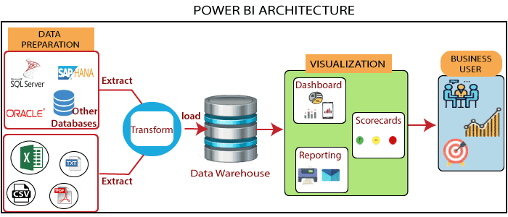
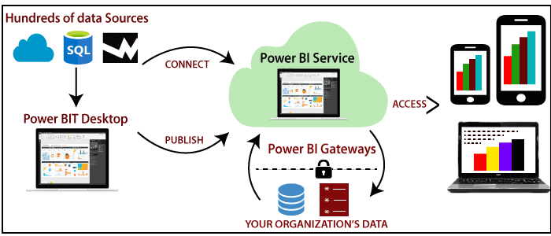
DFD DIAGRAM- POWER BI
Power BI Architecture
DFD Diagram

Slide 20
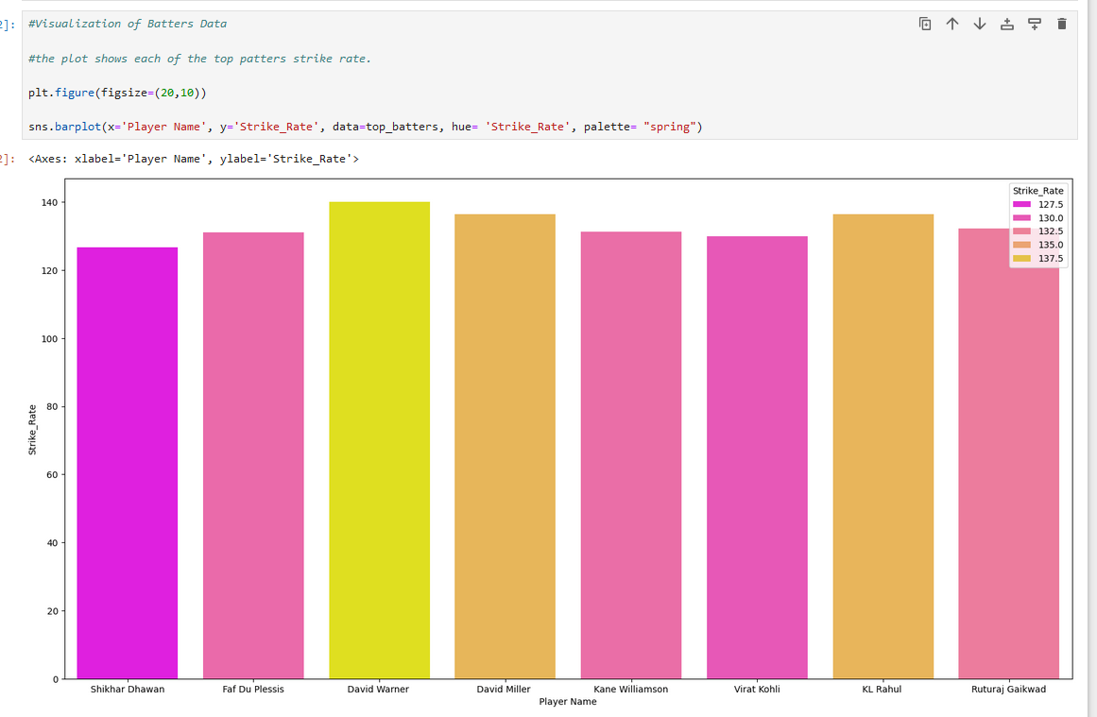
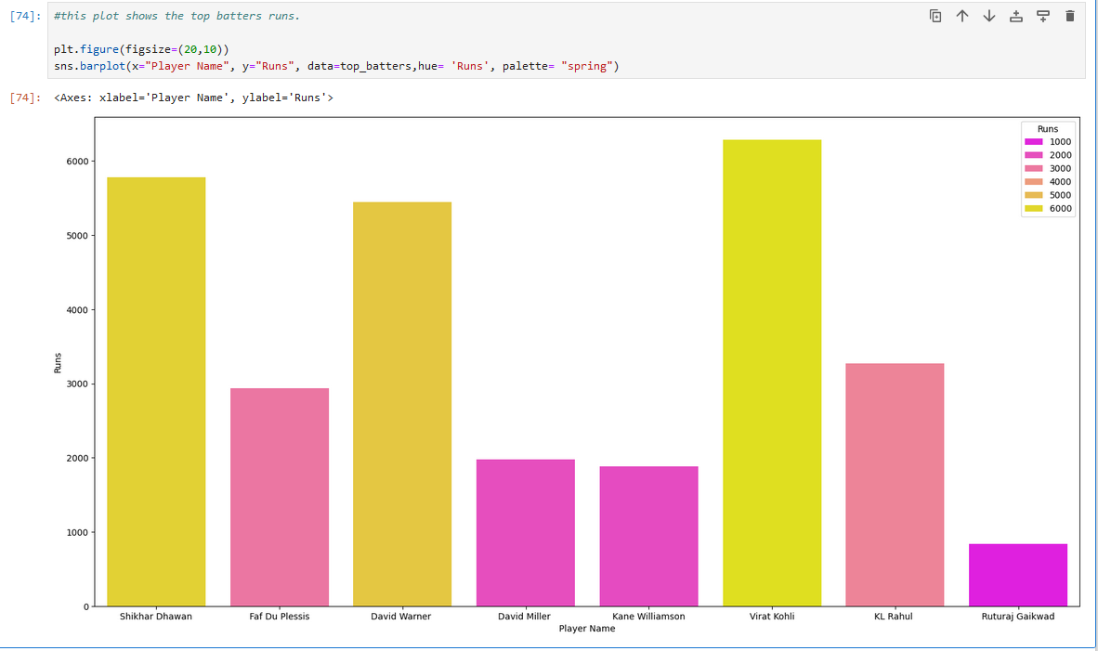
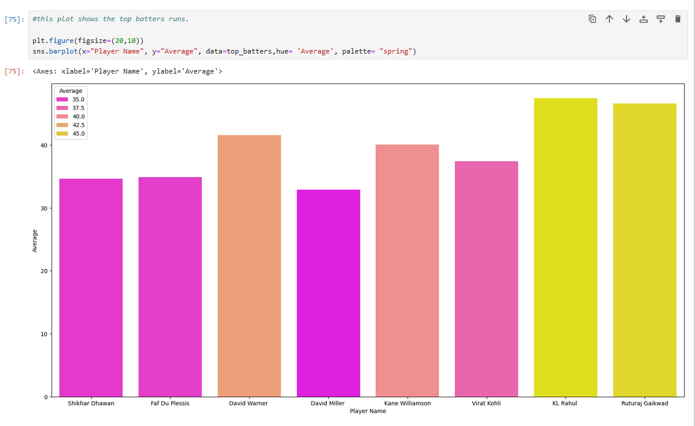
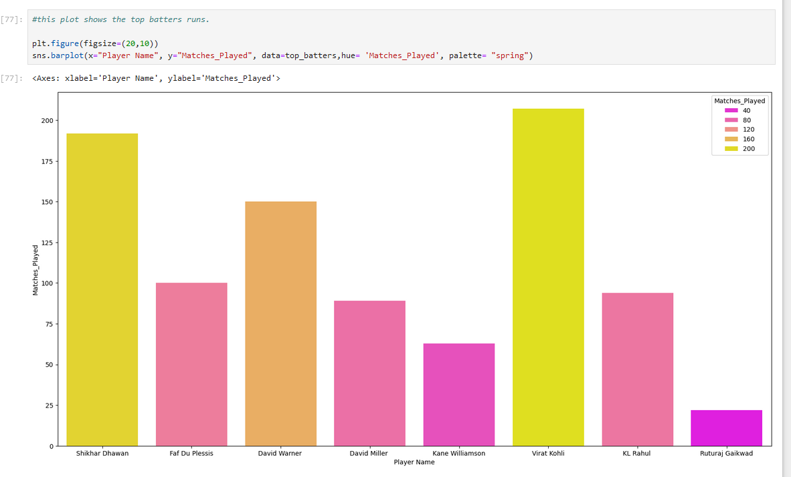
OUTPUT SCREENSHOTS- Visualization of Batters data
this plot shows the top batters Strike rate
this plot shows the top batters runs
this plot shows the top batters average
If we rank the top batters in order of 1-10 on the above parameters. The top 3 batters will be
KL Rahul
Virat Kohli
David Warner
this plot shows the top batters matches played

Slide 21
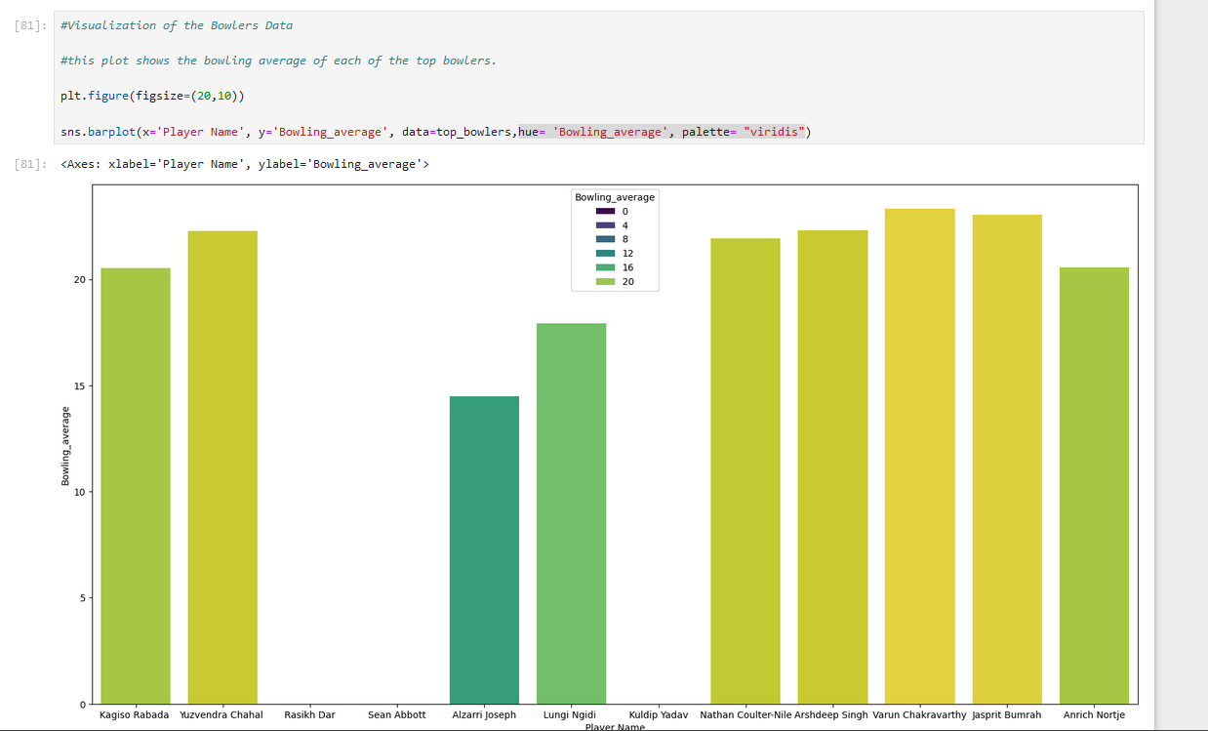
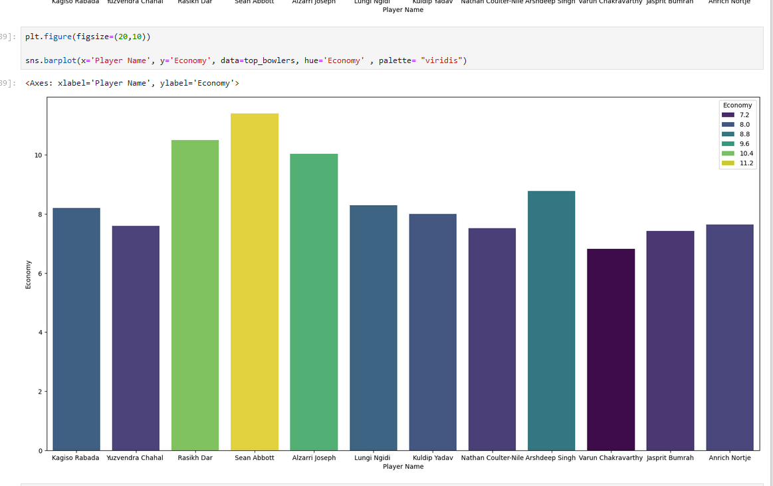
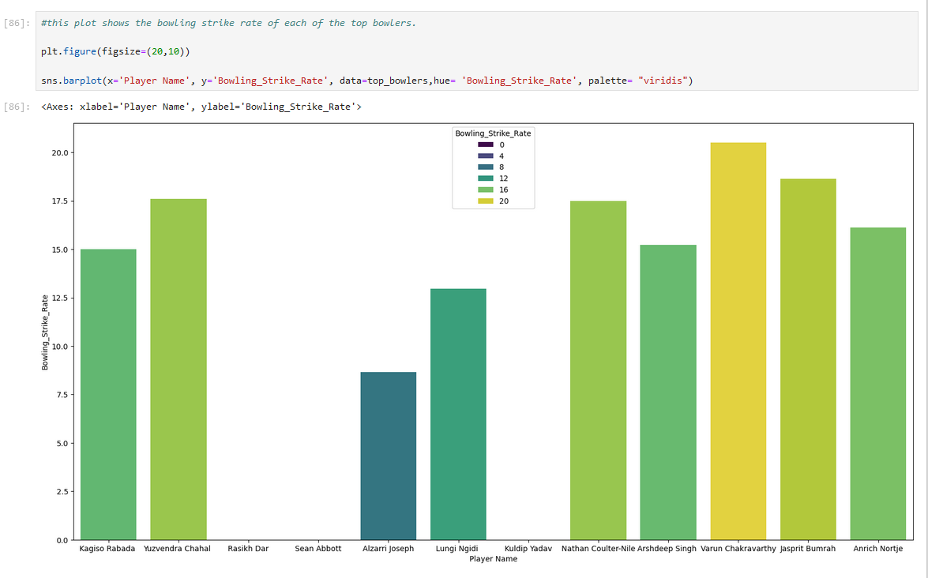
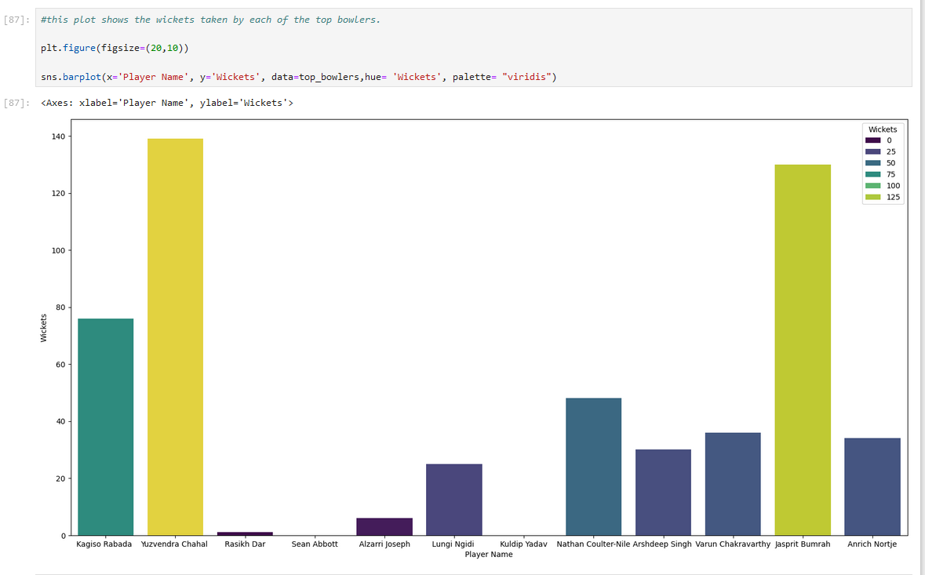
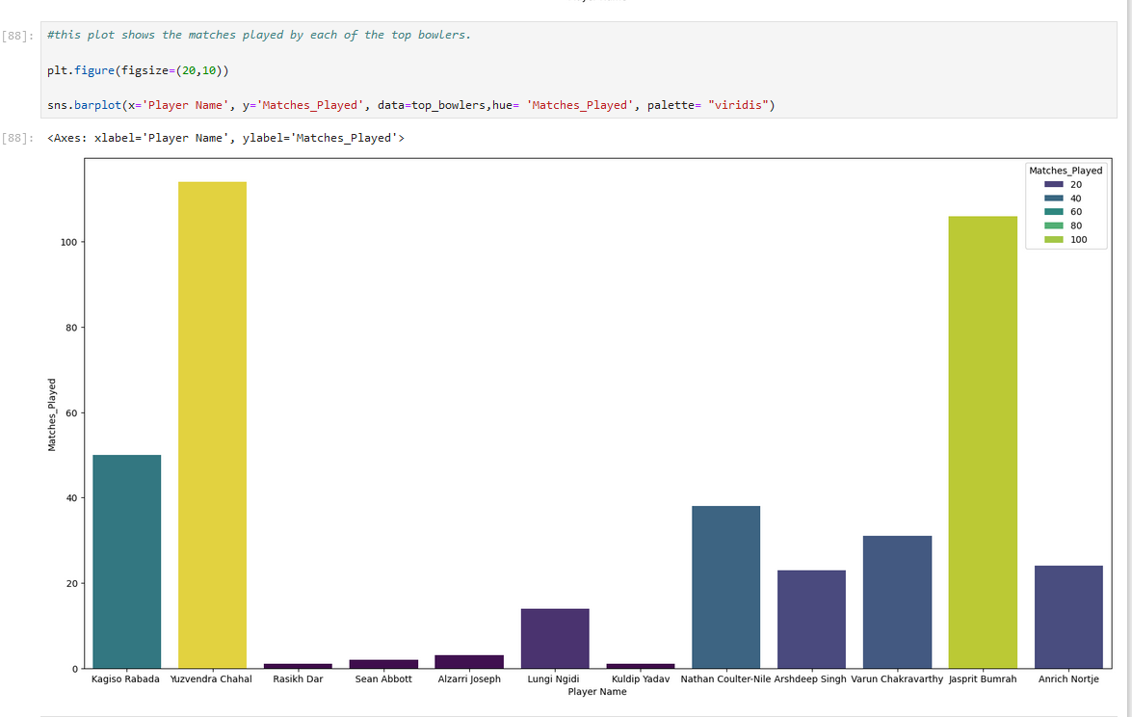
OUTPUT SCREENSHOTS- Visualization of Bowlers data
this plot shows the bowling average of each of the top bowlers.
this plot shows the economy of each of the top bowlers.
this plot shows the bowling strike rate of each of the top bowlers.
From the above analysis, if we rank down the parameters from 1-10. The top bowling options are as follows:
1. Kagiso Rabada
2. Jasprit Bumrah
3. Yuzvendra Chahal
4. Nathan Coulter-Nile
this plot shows the wickets taken by each of the top bowlers.
this plot shows the matches played by each of the top bowlers.

Slide 22
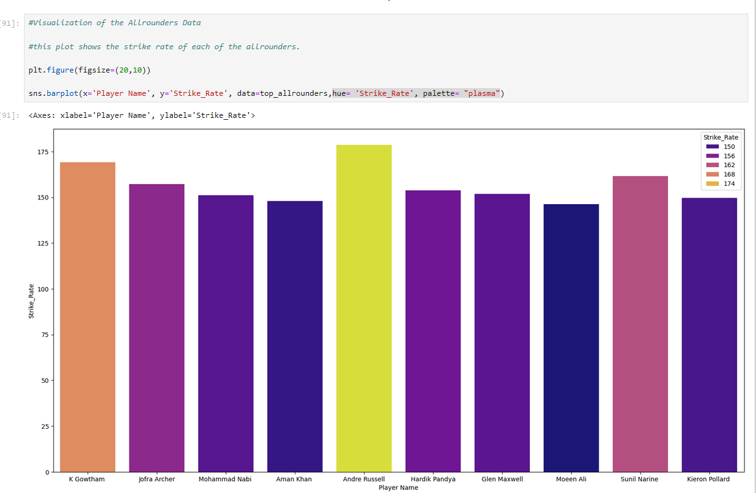
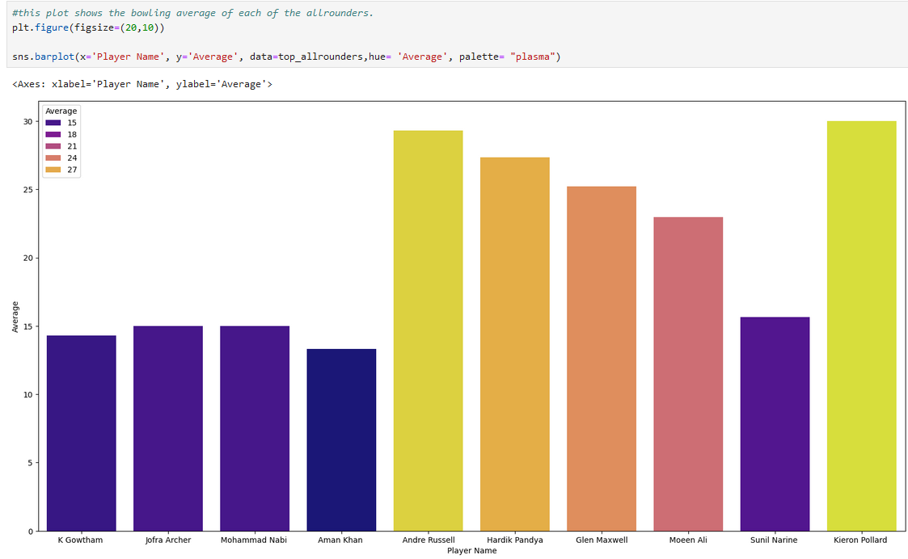
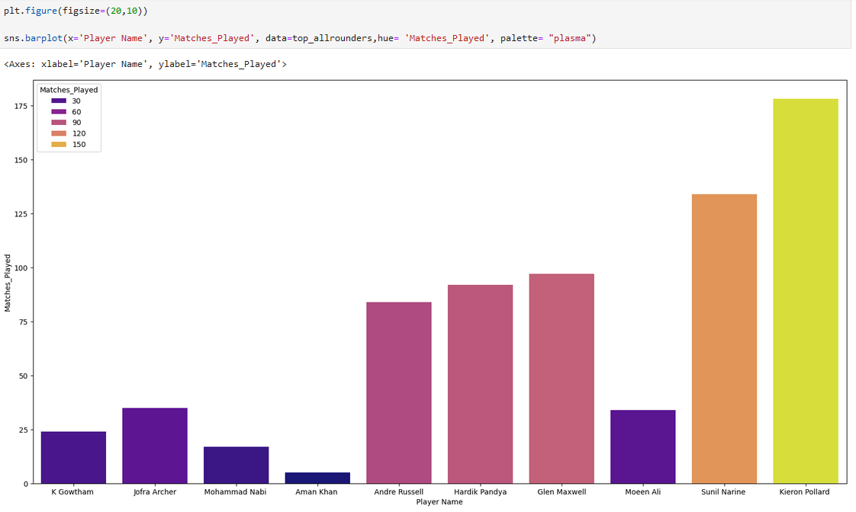
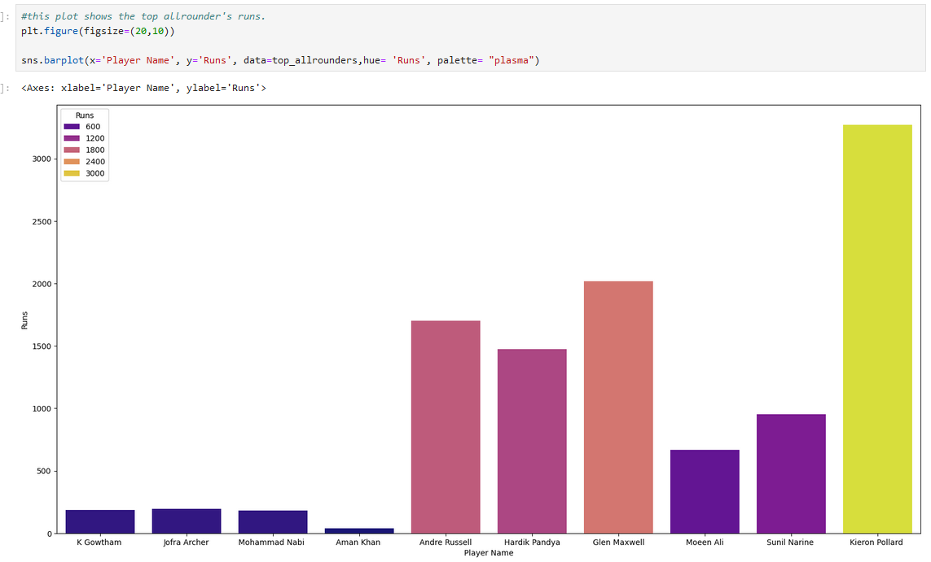
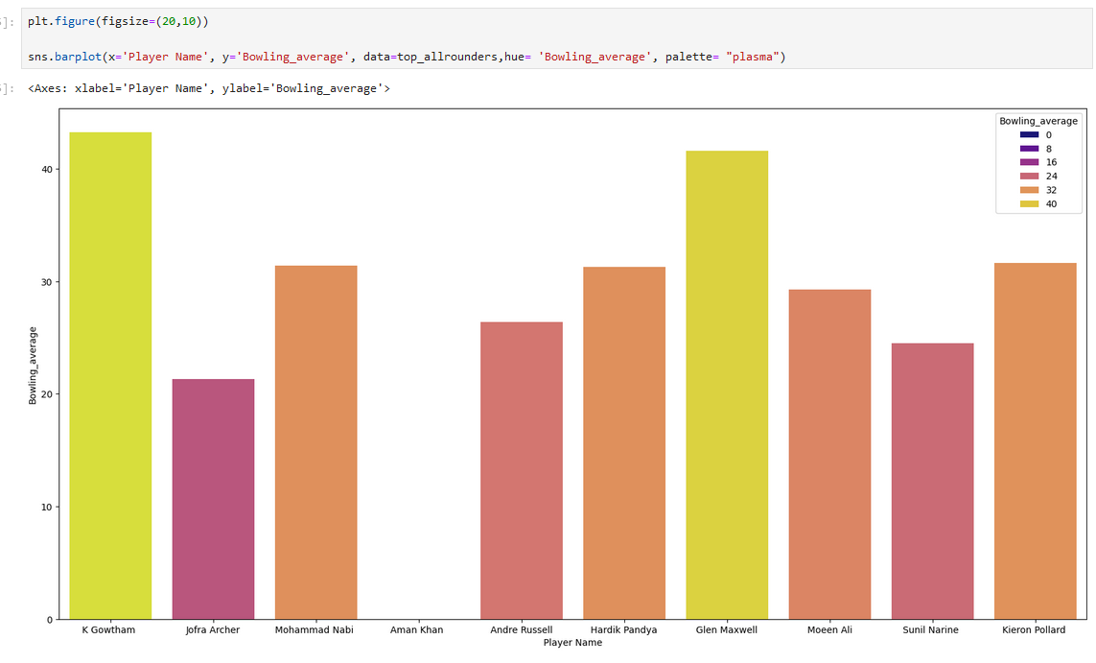
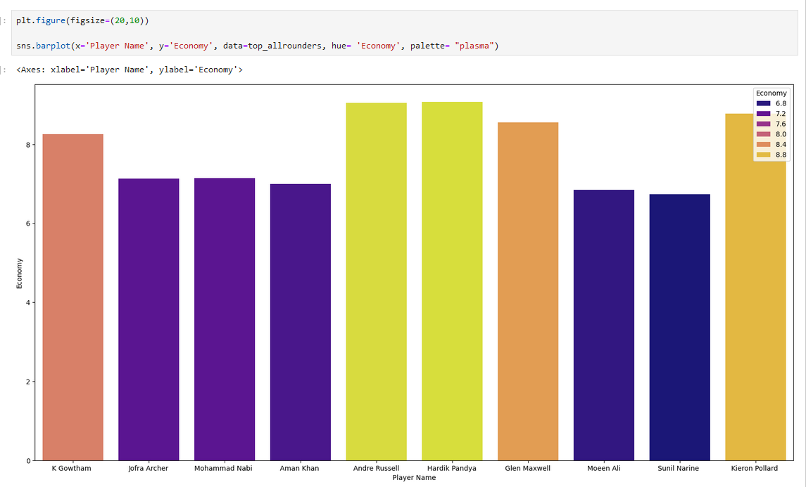
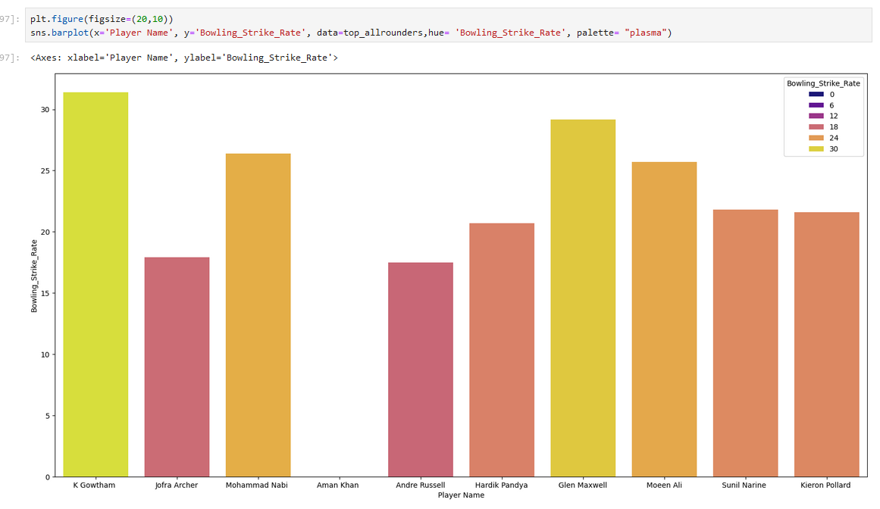
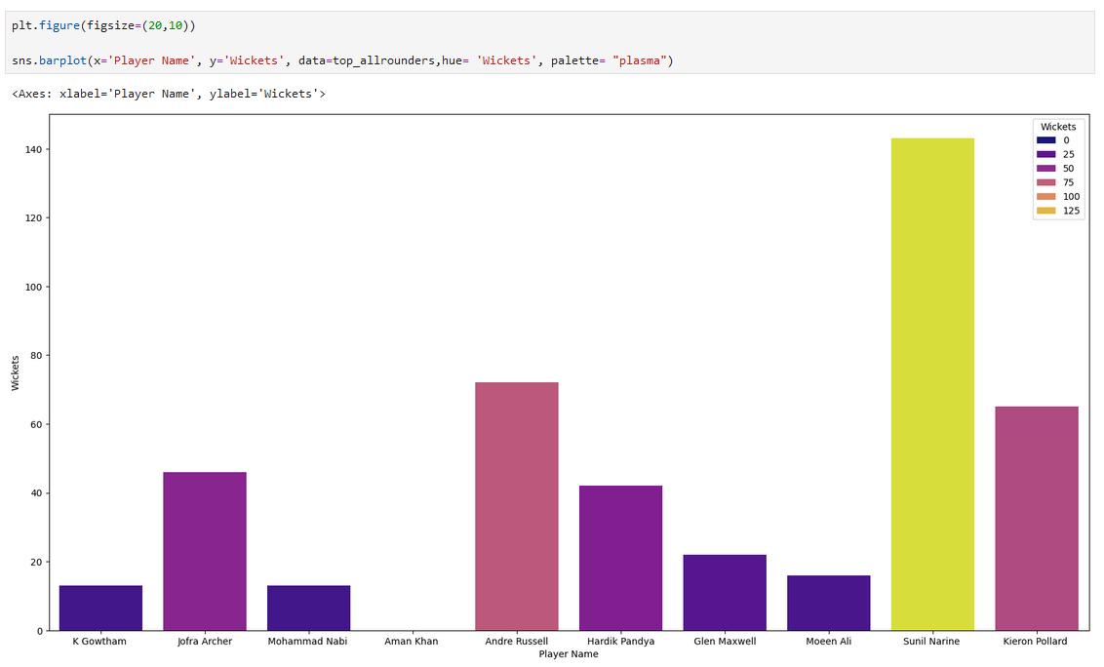
OUTPUT SCREENSHOTS- Visualization of allrounders data
this plot shows the strike rate of each of the allrounders
this plot shows the average of each of the allrounders
this plot shows the matches played of each of the allrounders
this plot shows the runs of each of the allrounders
this plot shows the bowling average of each of the allrounders
this plot shows the economy of each of the allrounders
From the above analysis, if we rank down the allrounders from 1-10 on various parameters. The top allrounder options are as follows:
1. Andre Russell
2. Sunil Narine
3. Hardik Pandya
4. Jofra Arche
this plot shows the bowling strike rate of each of the allrounders
this plot shows the wickets of each of the allrounders

Slide 23
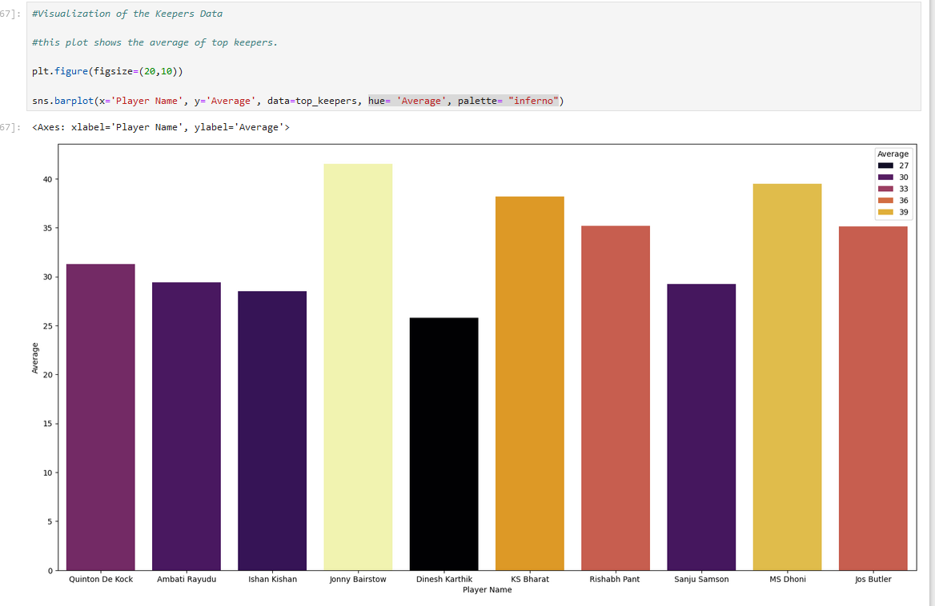
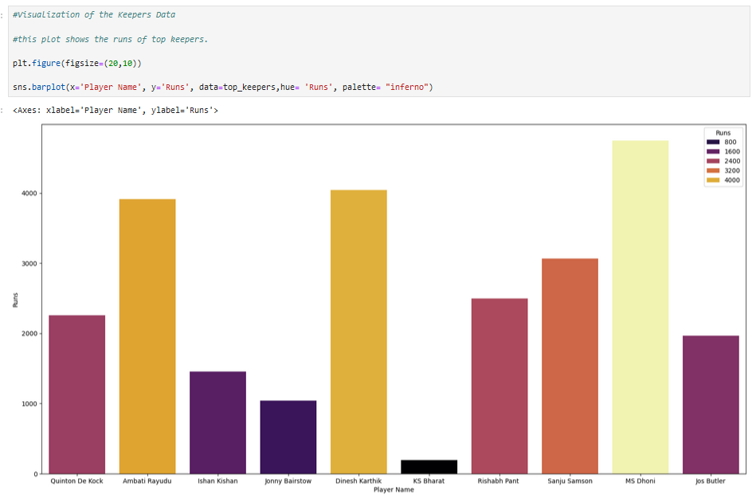
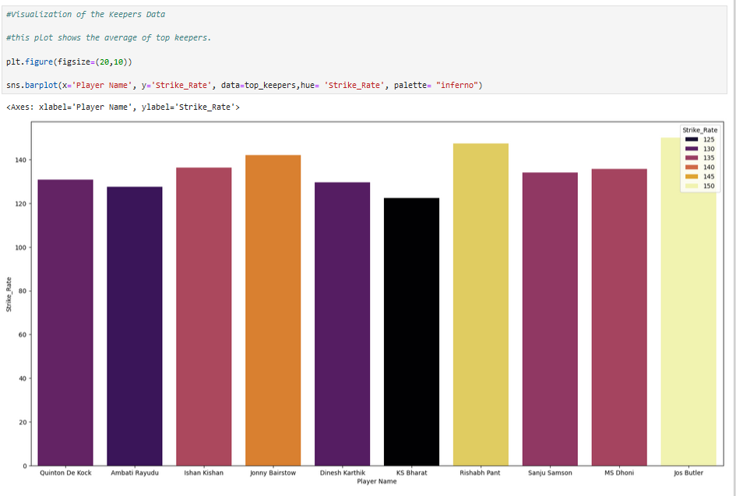
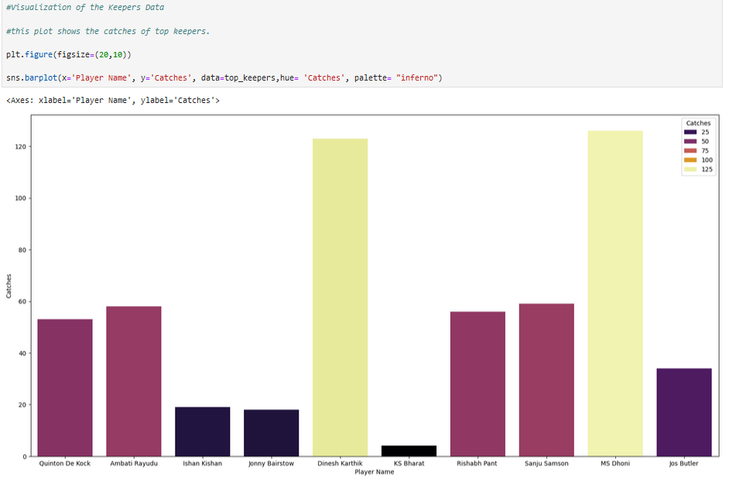
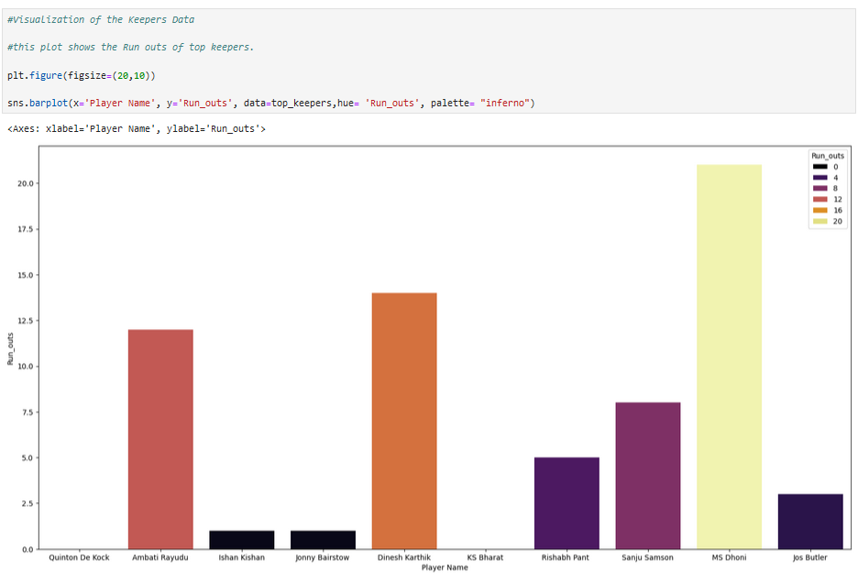
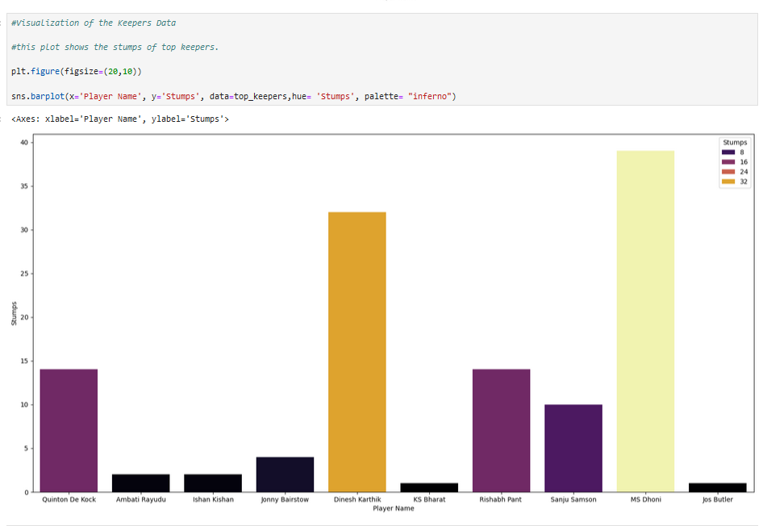
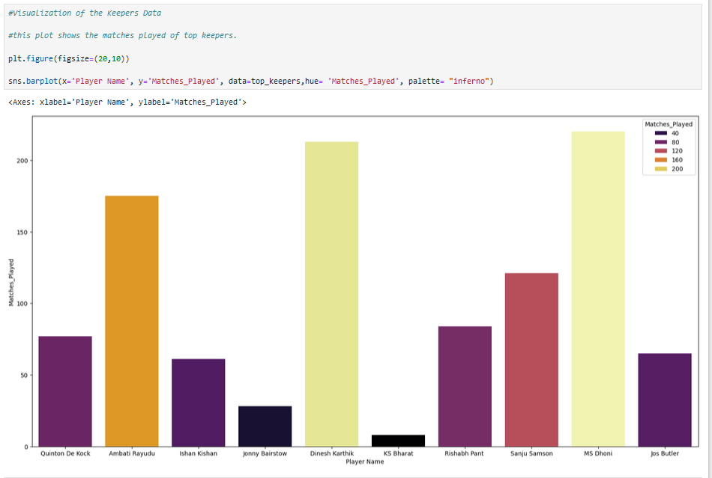
OUTPUT SCREENSHOTS- Visualization of Keepers data
this plot shows the average of top keepers.
this plot shows the runs of top keepers.
this plot shows the strike rate of top keepers.
this plot shows the Run outs of top keepers.
this plot shows the Stumps of top keepers.
this plot shows the catches of top keepers.
If we rank the keepers in order of 1-10 on the above parameters. The top 3 keepers will be
1. MS Dhoni
2. Dinesh Karthik
3. Rishabh Pant
this plot shows the matches played of top keepers.

Slide 24
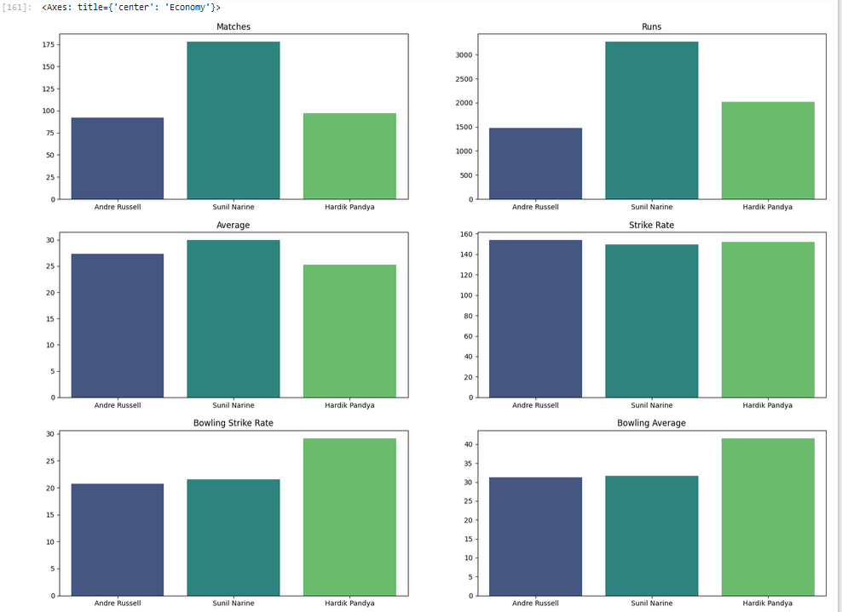
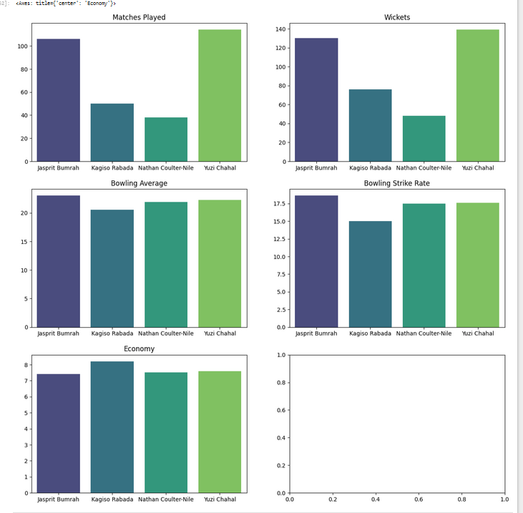
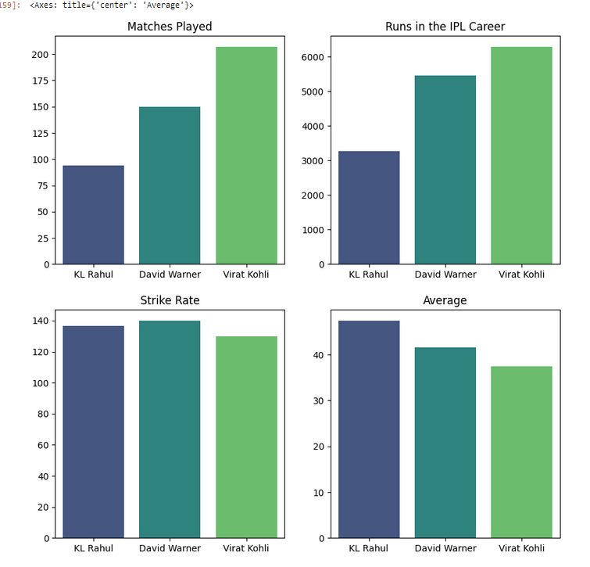
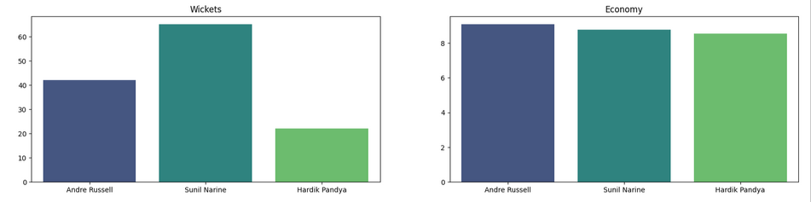
OUTPUT SCREENSHOTS - Formulating the Best XI
Batters for the Final 11- KL Rahul, Virat Kohli, David Warner
Allrounders for the final 11 - Andre Russell, Sunil Narine, Hardik Pandya
Bowlers for the final 11-Jasprit Bumrah, Kagiso Rabada, Nathan Coulter Nile, Yuzi Chahal

Slide 25
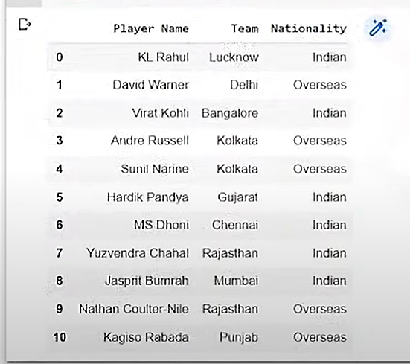
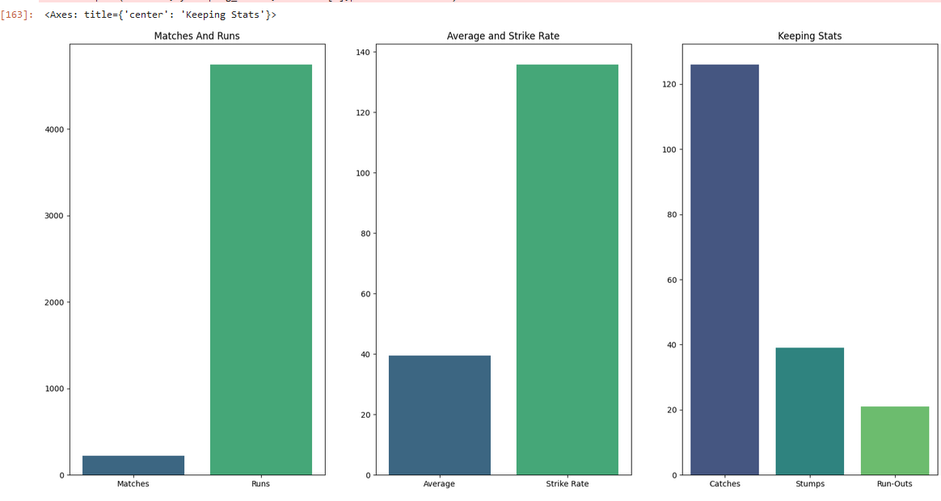
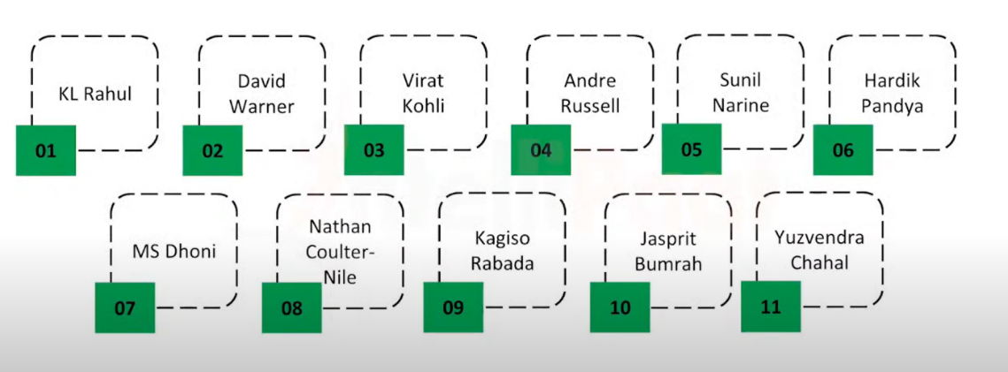
OUTPUT SCREENSHOTS- Formulating the Best XI
Wicket Keeper For The Final 11-MS Dhoni
Formulated the Best XI Players

Slide 26
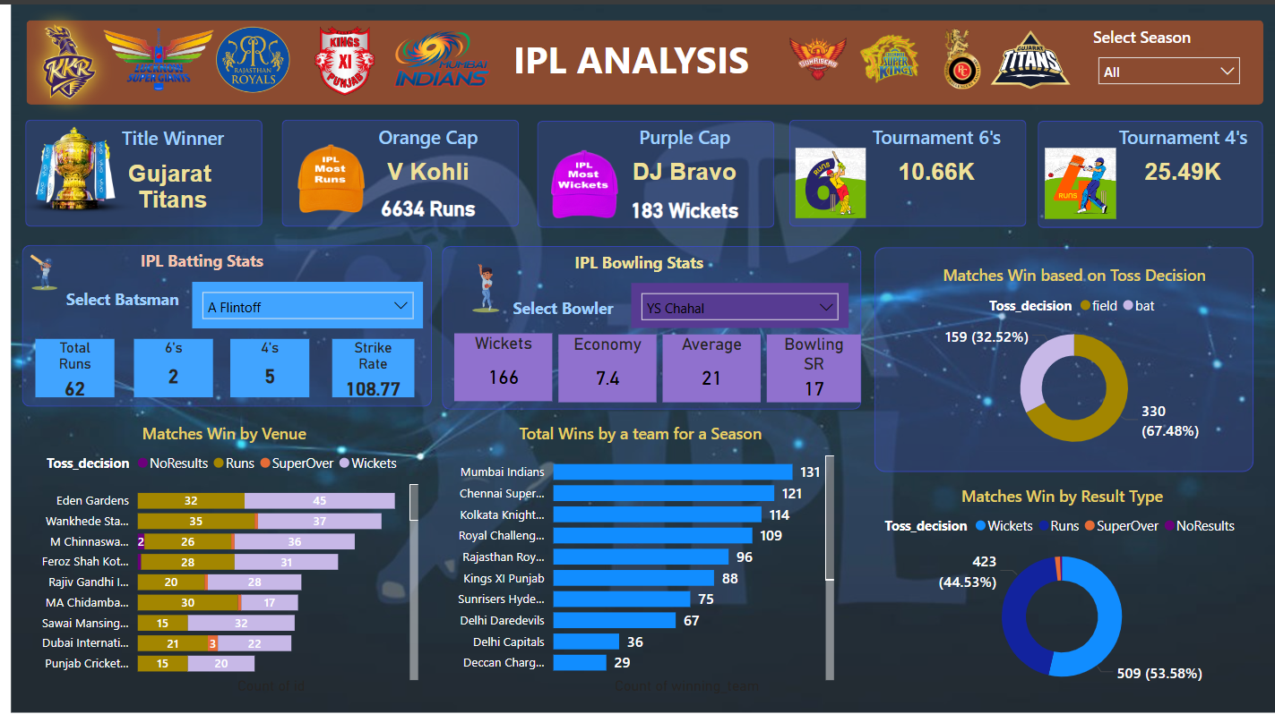
OUTPUT SCREENSHOTS
POWER BI DASHBOARD OF IPL DATA ANALYSIS

Slide 27
SOURCE CODE – GITHUB LOCATION
The Complete Source code is found in the following GitHub location: https://github.com/monalikaghosh7/IPL-Data-Analysis/tree/main The Complete IPL Analysis Power BI Dashboard is found in the following GitHub location: https://github.com/monalikaghosh7/Power-BI-dashboard

Slide 28
CONCLUSION
1. Comprehensive Approach :
- The project integrates modern data analysis technologies to collect, process, and visualize cricket data effectively.
2. Addressing Industry Needs :
- Provides data-driven insights into cricket performance metrics, match outcomes, and player statistics for analysts, coaches, teams, and fans.
3. Automated Data Collection :
- Utilized web scraping tools (BeautifulSoup, Selenium) to gather real-time data from platforms like ESPN Cricinfo and Cricbuzz efficiently.
4. Data Cleaning and Preparation:
- Processed raw data using Pandas to ensure consistency, accuracy, and readiness for analysis.
5. Exploratory Data Analysis (EDA):
- Leveraged Python libraries like Matplotlib and Seaborn to uncover trends, patterns, and actionable insights.
6. Interactive Dashboards :
- Built Power BI dashboards for user-friendly, interactive visualizations, enabling dynamic exploration and detailed analysis.
8. Impact on Sports Analytics :
- Demonstrates how modern data tools transform raw data into actionable insights, bridging the gap between data collection and decision-making.

Slide 29
FUTURE ENHANCEMENTS
1. Integration of Machine Learning Models : Implement predictive analytics to forecast player performance, match outcomes, and team strategies.
2. Support for Multiple Cricket Formats: Extend analysis capabilities to include Test matches, ODIs, and T20 leagues globally.
3. Real-Time Data Streaming: Enable live data streaming for in-game analytics and real-time decision-making.
4. Enhanced Data Sources: Expand data collection to include more platforms, such as social media sentiment analysis and fan engagement metrics.
5. Mobile Application Development :Create a mobile-friendly interface to make dashboards accessible to a broader audience, including fans and coaches.
6. Advanced Visualizations :Add 3D and animated charts for better storytelling and deeper insights.
7. Personalized Recommendations: Develop tools for recommending team lineups, auction strategies, or training focus areas based on data trends.
8. Cloud Integration: Use cloud platforms for scalable data storage and processing, enabling analysis of larger datasets.
9. Collaboration Features: Introduce shared dashboards and collaborative tools for analysts, teams, and coaches to work together in real-time.

Slide 30
REFERENCES
Books and Publications
[1]. Daniel MagoVistro, Faizan Rasheed, Leo Gertrude David, “The Cricket Winner Prediction With Application of Machine Learning And Data Analytics” International Journal of Scientific & Technology Research (2019)
[2]. Madan Gopal Jhanwar and VikramPudi, “Predicting the Outcome of ODI Cricket Matches: A Team Composition Based Approach” International Institution of Information Technology (2017)
[3]. I. P. Wickramasingheet. al, "Predicting the performance of batsmen in test cricket," Journal of Human Sport & Exercise”, vol. 9, no. 4, pp. (2017)
[4]. R. P. Schumaker, O. K. Solieman and H. Chen, "Predictive Modeling for Sports and Gaming” in Sports Data Mining, vol. 26, Boston, Massachusetts: Springer, (2016)
[5]. J. McCullagh, "Data Mining in Sport: A Neural Network Approach," International Journal of Sports Science and Engineering, vol. 4, no. 3 (2016)
[6]. Bunker, Rory &Thabtah, Fadi. “A Machine Learning Framework for Sport Result Prediction. Applied Computing and Informatics”. (2017)
[7] Kulkarni, V. & Sinha, P., n.d. Effective Learning and Classification using Random Forest Algorithm. International Journal of Engineering and Innovative Technology (IJEIT).
[8] Lokhande, A., Chawan, R. &. &Pramila&, S., 2018. Prediction of Live Cricket Score and Winning. Computer and IT Dept, VeermataJeejabai Technological Institute, Mumbai, India, 5(4)(2394-9333).
[9] Mitchel, M. T., 1997. Machine learning. Burr Ridge, IL: McGraw Hill, 45, 1997.
[10] Murphy, K. P., 2006. Naive bayes classifiers. University of British Columbia.
Complete Source code is found in the following GitHub location: https://github.com/monalikaghosh7/IPL-Data-Analysis/tree/main

Slide 31

THANK YOU

